Slide 1
Arithmetic
Arithmetic Operators | Compound Assignment Operators | Arithmetic With Numbers and Strings | Comments and Semicolons
Notes:
Welcome to our lecture on JavaScript syntax and variables. In this lecture we will go through javaScript background, variables, data types, comments and semicolons, input and output. Let’s start our lecture.

Slide 2
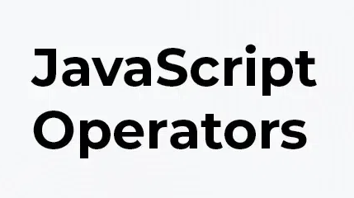
Arithmetic Operators
Expressions: Combine variables, numbers, operators, and parentheses to compute values (e.g., y = 2 * (x + 1)).
Arithmetic Operators: Perform calculations in expressions, like + for addition and * for multiplication.
Notes:
Arithmetic operators are used in expressions to perform calculations. An expression combines variables, numbers, operators, and parentheses to compute a value, like y = 2 * (x + 1). Arithmetic operators include + for addition, - for subtraction, * for multiplication, and / for division. These operators make it easy to perform mathematical operations in JavaScript programs.

Slide 3
Variables
Variable Declaration: Declares a variable with let followed by the name (e.g., let score).
Assignment & Initialization: Assign values later (e.g., score = 2) or during declaration (e.g., let maxValue = 5).
Best Practice: Always declare a variable before assigning a value.
Notes:
Now move on to Variables that are declared using the let keyword followed by the variable name, like let score. Values can be assigned later, such as score equal to 2, or during declaration, like let max Value equal to 5, which is called initialization. It is best practice to always declare variables before assigning values to ensure clarity and prevent errors in your code.

Slide 4
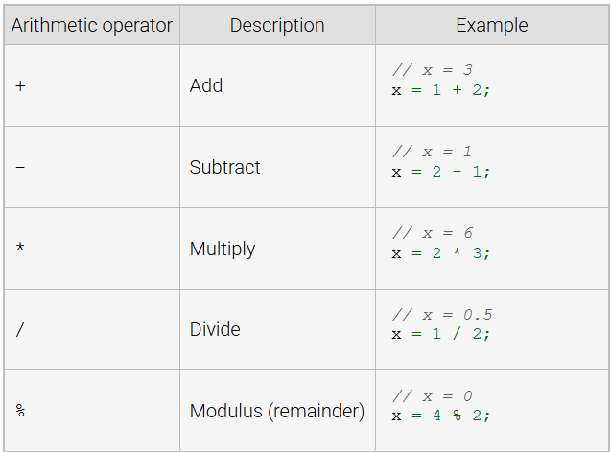
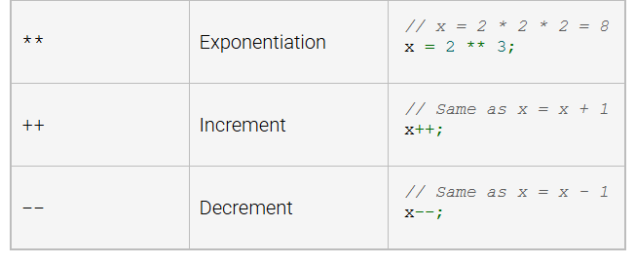
JS Arithmetic Operators
Notes:
JavaScript provides several arithmetic operators for calculations. Basic operators include plus for addition, minus for subtraction, asterisk for multiplication, back slash for division, and percentage for modulus (remainder). Advanced operators include double asterisk for exponentiation, double plus for incrementing, and double minus for decrementing. These operators are essential for performing mathematical operations in JavaScript code.

Slide 5
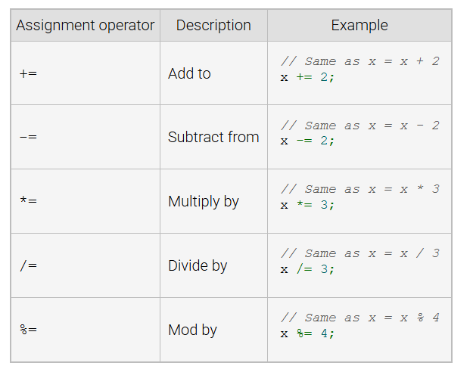
Compound Assignment Operator
A compound assignment operator combines an assignment statement with an arithmetic operation. Common JavaScript compound assignment operators are summarized in the table below.
Notes:
A compound assignment operator combines an arithmetic operation with assignment, making code more concise. For example, plus equals adds a value to a variable, same as x equals x plus 2. Other operators include minus equals for subtraction, multiply equals for multiplication, divide equals for division, and mod equals for modulus. These operators simplify repetitive operations in JavaScript.

Slide 6
Arithmetic with Numbers and Strings
String Concatenation: The + operator appends one string to another (e.g., "back" + "pack" becomes "backpack").
Operand Type: The meaning of + (add or concatenate) depends on the types of the operands.
Notes:
The plus operator in JavaScript is used for both arithmetic addition and string concatenation. For strings, it appends one string to another, like back plus pack becomes backpack. The behavior of the plus operator depends on the operand types. If both are numbers, it adds them; if one or both are strings, it performs concatenation.

Slide 7
Rules for Arithmetic Numbers and Strings
Numbers: + adds numbers (e.g., 2 + 3 = 5).
Strings: + concatenates strings (e.g., "2" + "3" = "23").
Mixed Types: + converts numbers to strings and concatenates (e.g., "2" + 3 = "23").
Notes:
The plus operator behaves differently based on the operand types. For numbers, it performs addition for example 2 plus 3 equal to 5. For strings, it concatenates them, joining them into a single string like 2 plus 3 equal to 23. When operands are mixed, the number is converted to a string, and concatenation occurs 2 plus 3 equal to 23. This makes plus versatile in JavaScript.

Slide 8
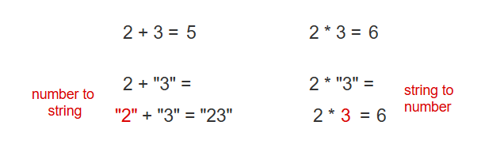
Example
Notes:
This example shows how JavaScript handles operations with numbers and strings. For plus, if both are numbers, it adds them like 2 plus 3 equal to 5. If one is a string, it converts the number to a string and concatenates like 2 plus 3 equal to 23. For asterisk, JavaScript converts strings to numbers if possible like 2 asterisk 3 equal to 6, performing arithmetic. The operator behavior depends on operand types. Thanks for watching the lecture.

